Slide 1
T1-T2 mapping of emulsions
NMR and MRI Application in Biotechnology

Slide 2
Emulsions
Emulsion is defined as the mixture of two or more liquids in which one is present as droplets, of microscopic or ultramicroscopic size, distributed throughout the other.
In the food industry, the two immiscible liquids are usually oil and water, but it is not always necessary.

Slide 3
Emulsions
Oil-in-water (O/W) emulsion: an emulsion consisting of oil droplets dispersed in aqueous phase (milk, cream, ice-cream, mayonnaise, beverages and sauces)
Water in oil (W/O) emulsion: an emulsion that consists of water droplets dispersed in an oil phase (margarine)
The material that makes up the droplets is usually referred to as the “dispersed phase”, “discontinuous phase” or “internal phase”.
The material that makes up the surrounding liquid is referred to as the “dispersing phase”, “continuous phase” or “external phase”.

Slide 4
Emulsions
Emulsions are formed from the component liquids either spontaneously or, more often, by mechanical means, such as agitation, provided that the liquids that are mixed have no (or a very limited) mutual solubility.
Unstable emulsions eventually separate into two liquid layers.
The preparation of emulsions that are kinetically stable over time period that is of practical use to the food industry requires the incorporation od substances known as stabilizers.

Slide 5
Emulsions
Stabilizers can be classified according to their mode of operation as either emulsifiers or texture modifiers.
An emulsifier is a surface-active substance that absorbs to the surface of emulsion droplets to form a protective coating that prevents the droplets from aggregating with one another.
An emulsifier also reduces the interfacial tension and therefore facilitates the disruption of emulsion droplets during homogenization, which aids in the formation of emulsions containing smaller droplets.

Slide 6
Emulsions
A texture modifier is a substance that either increases the viscosity of the continuous phase (Thickening agent) performs a gel network within the continuous phase (gelling agent), thereby slowing down the movement of droplets due to gravity or Brownian motion, as well as providing the product with characteristic textural attributes.

Slide 7
Emulsions
Stabilizers are compounds that typically have a polar or hydrophilic part and a non-polar (i.e. hydrophobic or lipophilic) part. Because of this, emulsifiers tend to have more or less solubility either in water or in oil.
Stabilizers that are more soluble in water will generally form oil-in-water emulsions, while emulsifiers that are more soluble in oil will form water-in-oil emulsions.

Slide 8
Emulsions
Examples of food stabilizers are:
Egg yolk – in which the main emulsifying agent is lecithin.
Mustard – where a variety of chemicals in the mucilage surrounding the seed hull act as emulsifiers
Soy lecithin is another emulsifier and thickener
Sodium phosphates
Mono- and diglycerides - a common emulsifier found in many food products (coffee creamers, ice-creams, spreads, breads, cakes)

Slide 9
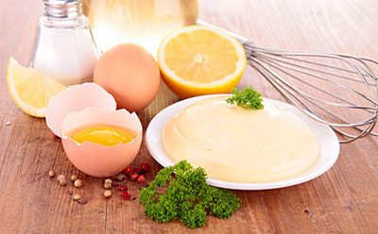
Example of food emulsion: Mayonnaise
Mayonnaise is a thick, creamy sauce or dressing that is an example of a stable emulsion.
A typical formulation for commercially made mayonnaise (not low fat) can contain as much as 80% vegetable oil, usually soybean but sometimes olive oil. Water makes up about 7% to 8% and egg yolks about 6%. Some formulas use whole eggs instead of just yolks. The remaining ingredients include vinegar (4%), salt (1%), and sugar (1%).

Slide 10
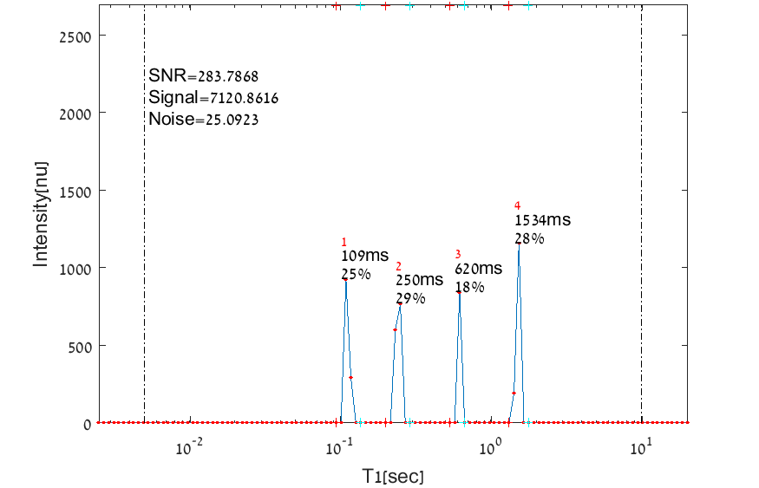
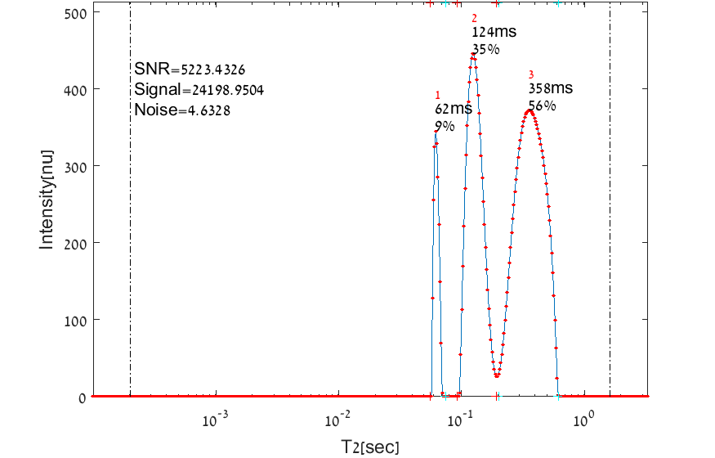
1D relaxation time spectra of mayonnaise
T1 relaxation time spectrum of mayonnaise
T2 relaxation time spectrum of mayonnaise

Slide 11
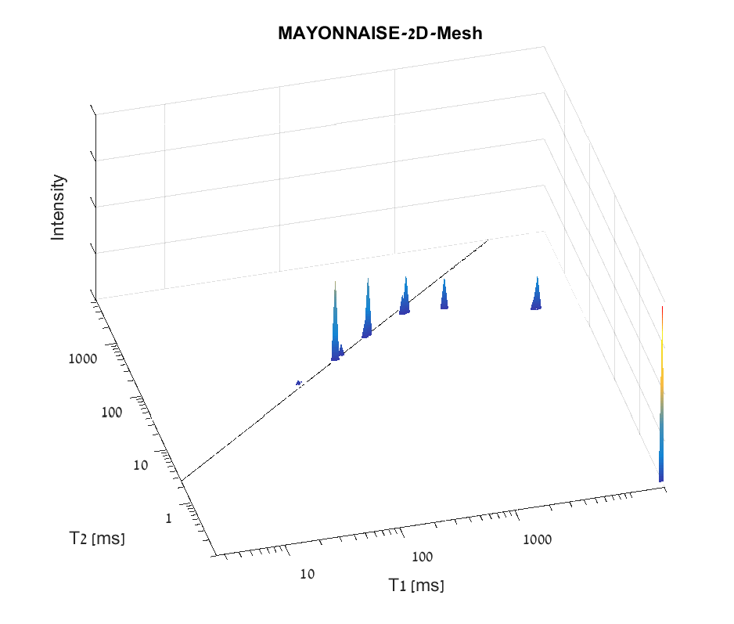
2D relaxation time spectrum of mayonnaise

Slide 12
Contact Information
Prof. Zeev Wiesman: wiesman@bgu.ac.il
Maysa Resende: mteixeiraresende@gmail.com
Dr. Janna Abramovich: janna@bgu.ac.il
Shosh Kravchick: kravch@bgu.ac.il
Plant Lipid Biotechnology Lab phone number: 074-7795272

